Slide 1
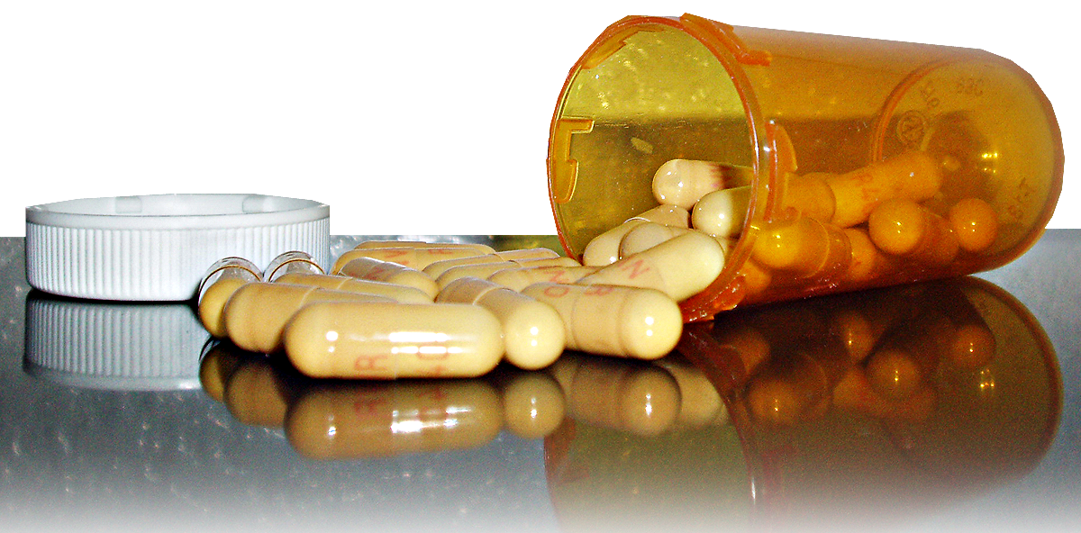
ON pharmaceutical drug monitoring
NIEM IMPACT
The Standard Prescription Monitoring Information Exchange Package Document

Slide 2
Prescription Drugs (15.1 million)
Cocaine (5.9 mil.)
From 1992-2003, 15.1 million Americans abused prescription drugs. That’s more than cocaine, hallucinogens, inhalants, and heroin COMBINED.
NATIONWIDE DRUG ABUSE
Hallucinogens (4 mil.)
Inhalants (2.1 mil.)
Heroin (.3 mil.)
During the same period, there was a 150% INCREASE in prescriptions written for controlled substances.
The brand cost of 4 mg of Dilaudid is $88.94 per 100. The street value for the same amount is $10,000. The demand is REAL.

Slide 3

1 in 5 teens are abusing prescription drugs to get high.
40% of teens
believe that prescription drugs are safer than illegal drugs.
29% of teens
believe that prescription pain relievers are not addictive.

Slide 4
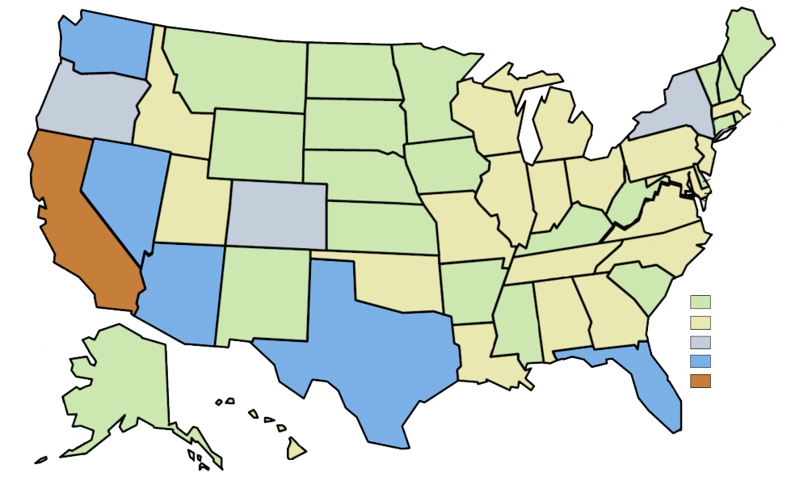
Pharmaceutical drug abuse is crossing state lines as offenders realize the gap in interstate reporting.
As this map shows, less than 20% of prescriptions written in California were written for California residents.
Where CA Prescriptions Really Go
> 0 – .9%
1 – 2.9%
3 – 3.9%
4 – 7%
> 19%
There are three facets to the problem—misuse, abuse, and diversion—and three players—prescribers, dispensers, and patients.
Prescription drug monitoring is the coming together of law enforcement, health care providers, and licensure boards to help prevent prescription drug abuse and diversion.

Slide 5
As diversion of prescription controlled substances and the abuse involving these drugs continues to escalate, how can we improve interstate monitoring of drug use?
How do we enable prescription drug monitors to see across state lines?

Slide 6

Before NIEM, there was large gap in interstate reporting.
As abuse and diversion escalate, law enforcement and health practitioners need a standardized, scalable solution to share patient drug history.
The Prescription Monitoring Program Information Exchange Package Documentation (IEPD) assists law enforcement, health agencies, and prescribers in identifying potential abuse and diversion.

Slide 7
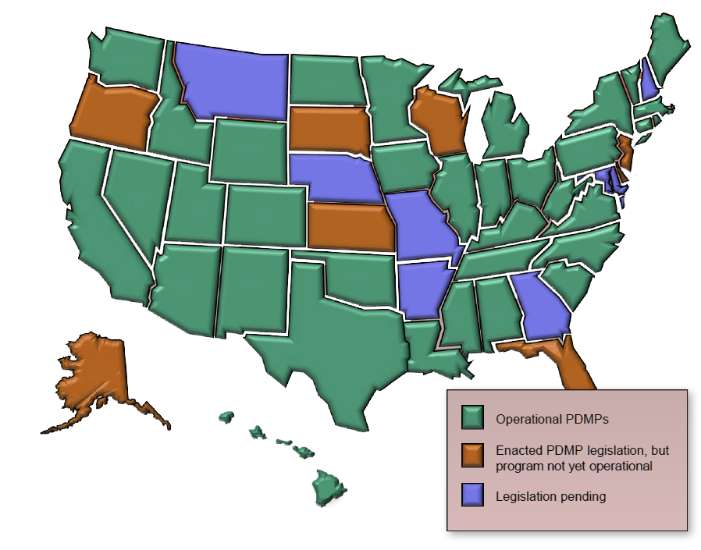
The Prescription Monitoring Information Exchange uses NIEM to empower connections:
73,000 Pharmacies 284,000 Pharmacists 1,600,000 Prescribers 54 Licensure Boards 18,000 Law Enforcement Agencies 11,000 Substance Addiction Treatment Programs
This is a solution that the 50 states, Canada, and Mexico can leverage.
This map identifies the status of
Prescription Drug Monitoring Programs (PDMPs)
Notes:
Number of Pharmacists (http://www.bls.gov/oco/ocos079.htm)
2008 269,900
2009 274,490
2010 279,080
2011 283,670
2012 288,260
2013 292,850
2014 297,440
2015 302,030
2016 306,620
2017 311,210
2018 315,800
Number of Boards of Pharmacy (http://www.nabp.net/boards-of-pharmacy/)
Number of Pharmacies
http://oig.hhs.gov/oei/reports/oei-05-06-00320.pdf
Of the 73,398 pharmacies included in the NCPDP file, 58,768 were classified as retail.
Number of Prescribers
http://www.ncpdp.org/products.aspx
Number of Consumer Protection Agencies (sum of S&L and Fed programs)
http://www.consumerworld.org/pages/agencies.htm
Number of HHS Substance Addition Treatment Programs
http://findtreatment.samhsa.gov/

